Slide 1
CUSTOMER RELATIONSHIP MANAGEMENT
CONCEPTS AND TECHNOLOGIES
Chapter 10
Managing networks for CRM performance

Slide 2
Competition is between networks not companies
In the 1920s Ford not only assembled cars. They also owned steel mills, coal-mines, iron ore mines, steam ships, rubber plantations, sheep farms and railroads. It was standard practice for companies to own and manage as many factors of production that they could.
In year 2000, Ford only produced about 50% of the value of their cars. The rest was outsourced to members of their supplier network. In Ford’s strategic group, General Motors produces 70% of the value of its cars, Chrysler 30% and Toyota only 20%.

Slide 3
Wal*Mart’s commitment to suppliers
Wal*Mart looks for a very close relationship and strong commitment from its key vendors. Highly valued: trust and integrity
Wal*Mart is willing to listen to new solutions, opinions and ideas. Don’t be afraid to contribute
Analytical skills are essential when dealing with Wal*Mart. We will give you access to all kinds of data. Use the data to build a win-win relationship
Wal*Mart is hungry for consumer insight. We place great value on any information that can improve our understanding of the people who shop in Wal*Mart stores
Prepare to engage management. Wal*Mart management is as keen as anyone to hear what business partners have to say. Don’t feel bound by hierarchy or categories

Slide 4
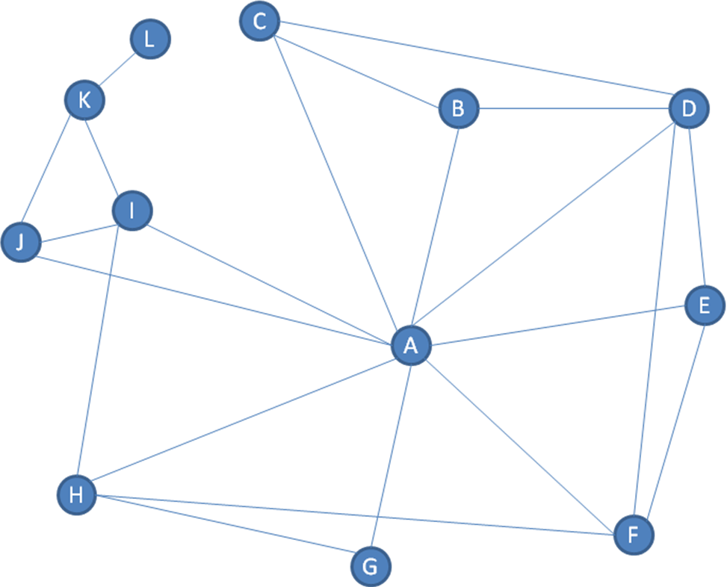
Network definition
A network is a structure made up of nodes that are related to each other by threads.

Slide 5
Business network definition
A business network is made up of nodal companies, organisations and individuals, and the relationships between them.
In the context of business markets, the nodes are business units such as suppliers, producers, distributors, partners, regulators, contractors, customers, and other companies, organisations and individuals. The relationships between these business units are expressed in actor bonds, activity links and resource ties.

Slide 6
Network position definition
A company’s network position is the sum total of a company’s network relationships and all the activity links, resource ties and actor bonds that these relationships contain.

Slide 7
Explaining network position 1
Every company occupies a network position.
Network positions are the products of an organisation’s past and present operations. They result from relationships and interactions that were, or are, needed for the firm to do what it was set up to do.
Every company in every network occupies a particular position in relationship to other members.

Slide 8
Explaining network position 2
A company’s network position is a resource that can create competitive advantage.
Networks supply the resources and perform the activities that enable companies to create and deliver value to their customers.
Network positions are dynamic. Members adapt their network positions to ensure their survival and prosperity.

Slide 9
Networks and CRM
Networks are important from a strategic CRM perspective
Network members supply the material inputs, services, funding, people, technology and knowledge that are used to create value propositions for the focal firm’s customers.
Network members also provide services such as advertising, logistics, and distribution that help raise and satisfy customer demand.

Slide 10
Network competence explained
Whether a desired network position is achieved is determined at least in part by the firm’s network competence.
  This is the firm’s ability to accrue and/or utilize the necessary knowledge, skills, qualifications and experience to successfully manage network interactions

Slide 11
The S.C.O.P.E. of CRM
Partners
Customers
Suppliers
Employees
Owners/investors

Slide 12
Toyota’s supplier network
First
tier
supplier
First
tier
supplier
Lateral coordination
Second
tier
supplier
First
tier
supplier
Toyota
Second
tier
supplier
First
tier
supplier
Second
tier
supplier
Second
tier
supplier
Third tier supplier
Fourth
tier supplier
Fifth tier supplier

Slide 13
Kodak’s supplier classification
World-source supplier
  Required sources of specified products. Global suppliers. Prices negotiated centrally. Formal variance approval required for purchasing from other sources.
Preferred supplier
  Kodak identifies a few specific sources for a specific input. Purchasing from these sources is encouraged though not mandated. May have global or regional pricing agreements.
Niche supplier
  Specific suppliers of input for specific applications.

Slide 14
IBM’s distribution network in Italy
Other suppliers
IBM
Value added
distributors (VAD)
Joint venture partners
Software houses
Dedicated partners
Independent distributors
Full service retailers
Value added reseller
(VAR)
Installers
Home shopping companies
End user
End user
End user
End user

Slide 15
Common features of business networks
Networks comprise a variety of organisations that contribute in different ways to the performance of a focal organisation.
Companies bring different competencies, resources, relationships, management styles and histories to the network.
Quite possibly, each company will have been established and developed for different purposes, and may be working towards objectives that are in conflict with those of the focal firm.

Slide 16
Technology and business networks
CRM systems now include applications for managing
  Relationships with partners (PRM)
  Relationships with investors
  Relationships with employees (ERM), and
  Through integration with Enterprise Resource Planning (ERP), the relationships with suppliers.

Slide 17
Network competence
Network competence is required for the
  Management of networks, and
  Management in networks
A company that is high in network competence not only has the necessary knowledge, skills, and qualifications but also uses them effectively to manage relationships at the both the network level and the individual level

Slide 18
Management of networks
Identify network requirements
  Identify the business activities that must be performed by network members to create and deliver value for and from their chosen customers
Acquire network expertise
  Evaluate current network position to identify current network members and assess presence of resources and commitment to perform the activities required.
Manage network performance
  Brief network members so that they understand the focal company’s customers, and their role in creating value for them.

Slide 19
How network members contribute to CRM performance
Offering new customer insight.
  They may be able to improve the focal company’s understanding of its customers
Creating value-adds
  By better cost performance at meeting specifications, improved product quality or identifying new opportunities

Slide 20
Network partners at Tesco
Tesco has actively sought to create partnering programs with other organisations. Partners have included
Lunn Poly, one of the UK’s multiple travel agencies, to offer a discounted travel service to its customers
B&Q, a major home improvement chain to offer discounted ‘do-it-yourself’ and home-ware products
Royal Bank of Scotland to offer banking and other financial services
Direct Line to offer household insurance products
General Motors to enable customers to buy cars at discounted prices.
The objective of all these programs has been to win a greater share of customer spend.

Slide 21
Managerial roles in networks
The network architect designs a network for a given purpose.
The lead operator introduces particular businesses or individuals into the network.
The caretaker takes an overview of the performance of the network.

Slide 22
Technology partners for CRM implementations
Infrastructure vendors
Consultants
CRM software vendors
Systems integrators
Client
Process engineers
Data analyticsvendors

Slide 23
Management in networks
Challenging because relationships vary in their
  Importance
  Intensity
  Closeness
  Strength
  Adaptation
  Commitment
  Power distribution

